Slide 1
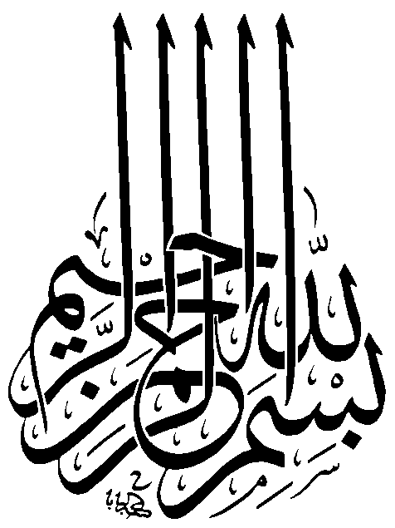

Slide 2
3:191 [and] who remember God when they stand, and when they sit, and when they lie down to sleep, ^{[146]} and [thus] reflect on the creation of the heavens and the earth: "O our Sustainer! Thou hast not created [aught of] this without meaning and purpose. ^{[147]} Limitless art Thou in Thy glory! Keep us safe, then, from suffering through fire!
Notes:
Thou hast not created this without meaning and purpose. What is the meaning and purpose can be known by creative thinking.

Slide 3
47:24 Will they not, then, ponder over this Quraan? - or are there locks upon their hearts?
Notes:
Keep your heart open to new ideas

Slide 4
It is no failure not to realize what you visualized. The failure is not to visualize what you might realize. Dee W Hock
Notes:
Keep your heart open to new ideas

Slide 5
Secret Two- Creativity
Creativity is generation of new ideas that satisfy some standard of value. 31
We must consider all alternatives
Notes:
Tow ladies claim a baby. Hazrat Ali decided to cut the baby into two and give half to each. The real mother gives up claim
To say half of 8 is 4 is correct but not new. Half of 8 is 100 is new but not correct. Both not creativity. To say half of 8 is 0 when cut horizontally or 3 when cut vertically seems to be somewhat creative.

Slide 6
Secret Two- Creativity
Reason for lack of creativity
Lack of courage to be rationale-Fear. (already discussed)
Inability to come up with new ideas. (focus of this lesson)

Slide 7
Secret Two- Creativity
Recognizing lack of creativity
Automatic Processes vs controlled process (better self vs habitual self.)
LEFT |  | LEFT
RIGHT |  | RIGHT
RIGHT |  | RIGHT
LEFT |  | LEFT
RIGHT |  | RIGHT
LEFT |  | LEFT
Notes:
Explain automatic and controlled cognitive processes
Controlled processing is intentionally done while we are consciously aware of what we are doing. ... Automatic processing does not require us to pay attention, nor do we have to deliberately put in effort to control automatic processes. Automatic processing occurs without us giving much thought to it.
Controlled process is reporting position of each word. Automatic process is reading each word aloud. Left table is easy because controlled and automatic process are same where as right one difficult because they are in conflict.
Some examples of automatic processes include motor skills, implicit biases, procedural tasks, and priming. The tasks that are listed can be done without the need for conscious attention. Implicit biases are snap judgments that people make without being aware that they made them.

Slide 8
Secret Two- Creativity
Understanding lack of creativity
Automatic Processes vs controlled process (better self vs habitual self.)
Controlled processing
Working memory
Capacity of working memory-7 numbers, 5 words, 3 thoughts
Automatic processing
Long term memory
Chunks- laid out in long term memory
Chunks inclines us to think in familiar manner and disinclines us to think creatively.

Slide 9
Secret Two- Creativity
Reasons for lack of creativity
Limited capacity for controlled cognitive process- limited working memory (desktop memory)
Priming
Priming is in between long term (indefinite) and short term memory (few seconds)
once ideas have been activated in working memory they tend to remain in a ready or primed state for a few days, so that our thoughts come back to them more readily.
Association and priming create intellectual box
Notes:
For explanation see example on next slide

Slide 10
Secret Two- Creativity
Recognizing lack of creativity
Consider the following problem
“ a father and his son were driving a sports car down a mountain road, when suddenly car spun off the road and crashed. Father was killed and son was seriously injured. Son was rushed to best hospital in the town, where the hospital’s surgeon summoned from a hunting trip was already waiting. On seeing the injured man, the surgeon said, I can’t operate on this boy he is my son.” (1)
Notes:
Maleness was primed by the words father, son, he

Slide 11
Secret Two- Creativity
Overcoming lack of creativity
Stimulus variation is a technique of teaching and refers to those teacher's actions which develop and maintain a high level or maximum attention on the part of the pupils during the course of a lesson e.g. mannerisms, voice, personality, media and materials used during instruction
Technology of Foolishness. Look beyond reasonable possibilities
Force fit Technology of Foolishness
Notes:
Page 36
Tech of foolishness- why would Columbus sail west to reach east, why to burn forests to have healthy forests?

Slide 12
Secret Two- Creativity
Overcoming lack of creativity
Force fitting and suspension of judgment.
Phase 1. In coming up with foolish stepping stone no evaluation
Phase 2. Moving from foolish stepping stone to possible solution positive evaluation be employed.
Phase 3. In valuating potential solution both positive and negative evaluation be employed.
Notes:
Ask students to think of a word. Tell them the problem. Try to force fit this in the solution

Slide 13
Secret Two- Creativity
Overcoming lack of creativity
Mood
Good mood
Put off if in bad mood
Observation- mindful observation of world around us, eg artist, writer, scientist
Creative conversation
Teaching
Devil’s advocate
Giant fighter’s stratagem- redirecting superior force of another to one’s own advantage.
Networking- who else do you suggest, I talk with.
Breaks- wake life or dream. Dreams are effect of priming
Check Lists
Notes:
Teaching: when you trying to explain a hypothesis to be wrong you suddenly feel that actually it was right
Creative thinking: Chinese proverb: A wise man learns more from a fool than a fools learns from a wiseman
Appointing a priest used devils advocate. He would give negative points of would be priest. When this practice was put off it was found that number of priest suddenly increased.
Giant fighters tech: buying a car. Discuss with seller of car A and then seller of car B.
Pilots use check lists

Slide 14


Slide 15
PAKISTAN ZINDABAD
پاکستان زندہ باد

